Slide 1
Carbon Neutral Crew
Melissa Avila
Fawn Payton
Lorenzo Howard
Sheniece Booker

Slide 2
Table of Contents
3. Introduction
9. Eligibility
4-5. Washington
10. MSRP: Data Clean Up
6-7. Trending and Top Ranked
11. EV Database Review
8. Range
12. Summary

Slide 3
Introduction
Carbon Neutral Crew
We are a charging station manufacture looking to expand our service areas. Our company has decided to review this dataset as preliminary research in our selection process. The dataset chosen is public from catalog.data.gov, so we do not have any issue with data privacy. We used CSV data, PostgresSQL, and utilized Bokeh as a new visualization library in Python.
In Washington state, the adoption of electric vehicles (EVs) has been accelerating at an impressive rate. As of now, more than 20% of new cars purchased in the state are electric, making Washington a leader in EV adoption across the nation.
With the increasing number of EVs on the roads, there is a growing need for expanding charging infrastructure to support these clean energy vehicles. To ensure that electric vehicle owners have convenient access to power when needed, Washington has been actively working to increase the availability of public EV charging stations. The state has already invested over 85 million dollars to fund nearly 5,000 new charging stations across various communities.
The data used provides intel on what we deem is most important to know early on: EV type/model and popularity, top utility companies, and growth of EV use by cities and counties.
As the transition to electric mobility continues, the development of more charging stations remains crucial to meet the demands of EV users and promote sustainable transportation options.

Slide 4
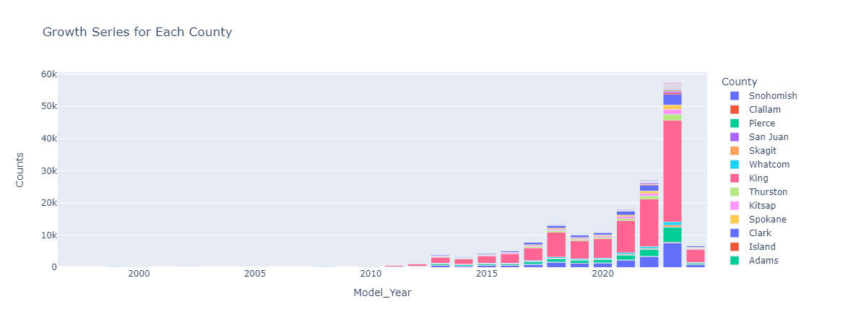
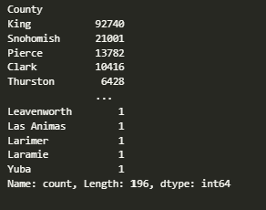

Washington: Top Ranking Counties
2023 models display the highest amount of growth of registered EVs for Washington counties
King county sits at the top with the highest total of 2023 model of EVs registered in Washington state – 92,740
The more rural counties - Leavenworth, Las Animas, Larimer, Laramie and Yuba tie for bottom 5.
Knowing the EV growth by county helps with targeting potential areas of charging station installation

Slide 5
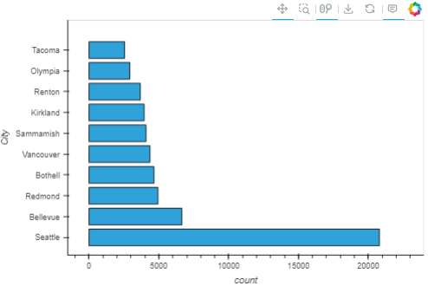
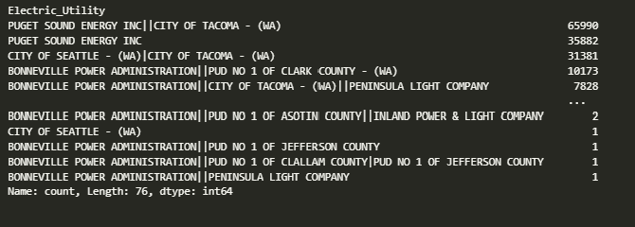
Washington: Top Ranking Utilities
Seattle is the top city with 20,800 EVs registered
The City of Seattle utility company ranks third, which could translate as a need for more infrastructure to meet the growth of EV use
Even though Tacoma ranks last in EVs registered, their utility ranks first. A first ranking utility could show potential for EV growth amongst utility customers

Slide 6
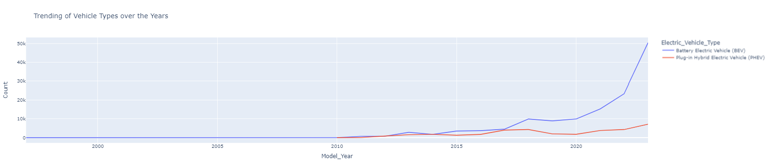
Electric Vehicles: Trending and Top Ranked
Battery Electric Vehicles (BEV) is continuously trending from 2020 and onward with 50k registered in 2023
Plug-in Hybrid Electric Vehicles (PHEV) do not seem to be as popular compared to BEVs with only 7k registering in 2023
Knowing what vehicles are popular provides us with an overall idea of the types of charging stations we would need to provide for the various models

Slide 7
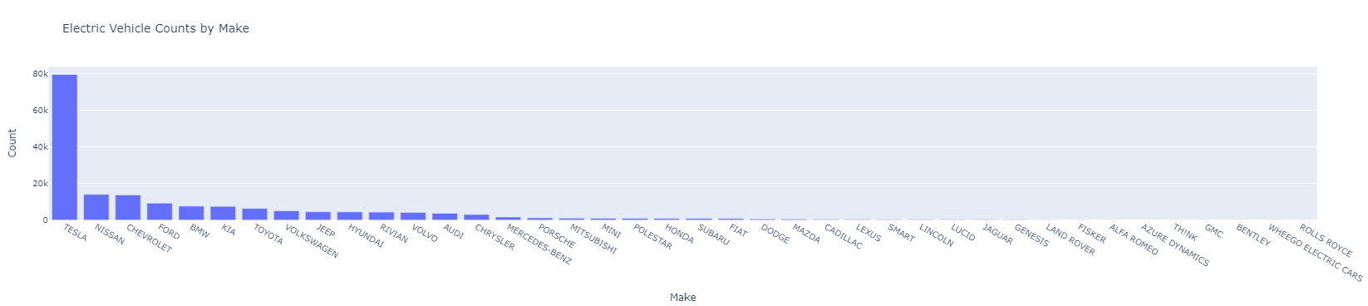
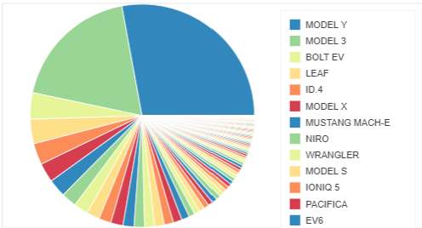
Electric Vehicles: Trending and Top Ranked
Tesla Models Y and 3 are the most popular
-Model Y - 35,479
-Model 3 - 23,899
Tesla is the overall popular choice followed by the Chevy Bolt EV and the Nissan Leaf
The least popular – KIA EV6

Slide 8
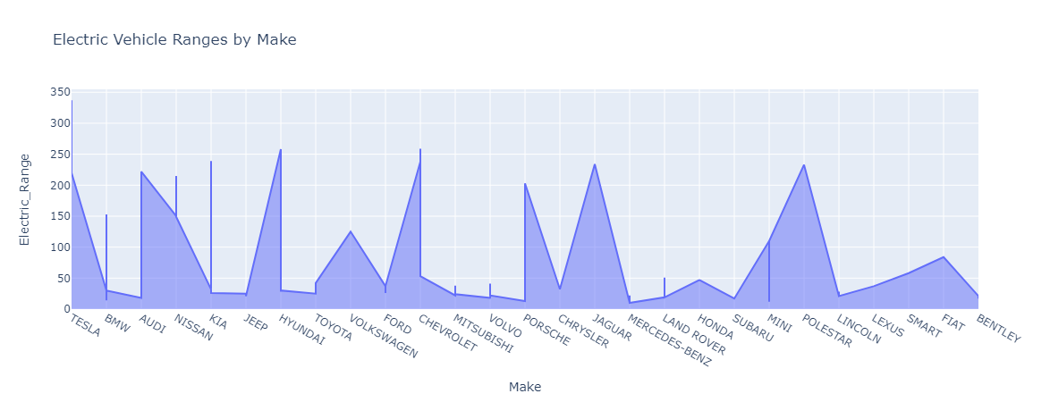
Range
Tesla ranks highest in electric range with 330 miles after a full charge
PHEVs such as Toyota, Mercedes and Mini cooper rank lowest
If we were to combine the electric range data with counties and cities, our company could get tangible idea of the best areas of placement for our charging stations which could be presented to utility providers

Slide 9
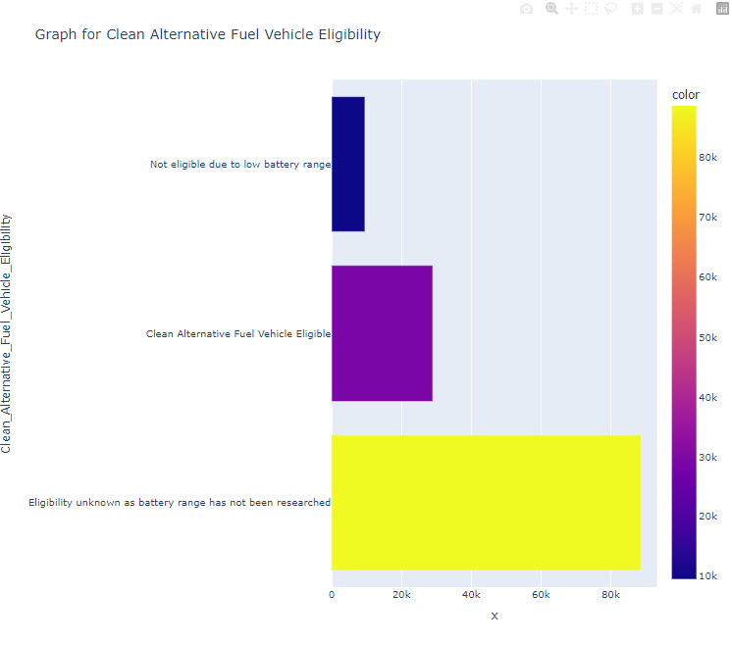
Eligibility
Clean Alternative Fuel Vehicle (CAFV) Eligibility is based on the fuel requirement and electric-only range requirement as outlined in the tax exemptions for Washington State
9k of the registered EVs are not eligible due to low battery range
-Ford
-Jeep
Toyota
28k of the registered EVs are eligible for the tax exemption
-Tesla
-Chevrolet
-Nissan
88k of the registered EVs eligibility is unknown due to battery not being researched

Slide 10
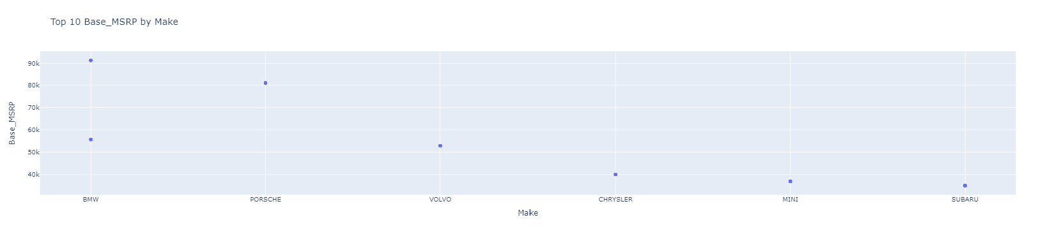
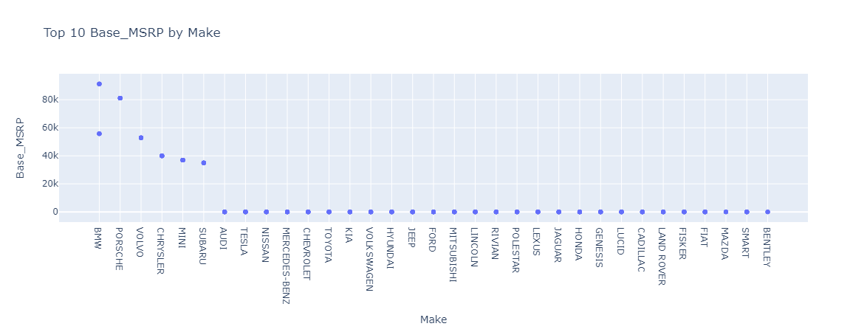
MSRP: Data Clean Up Issues

Slide 11
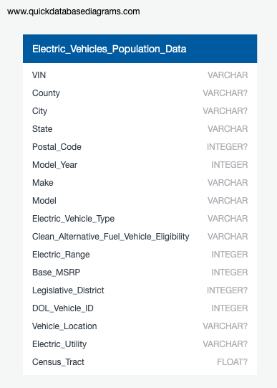
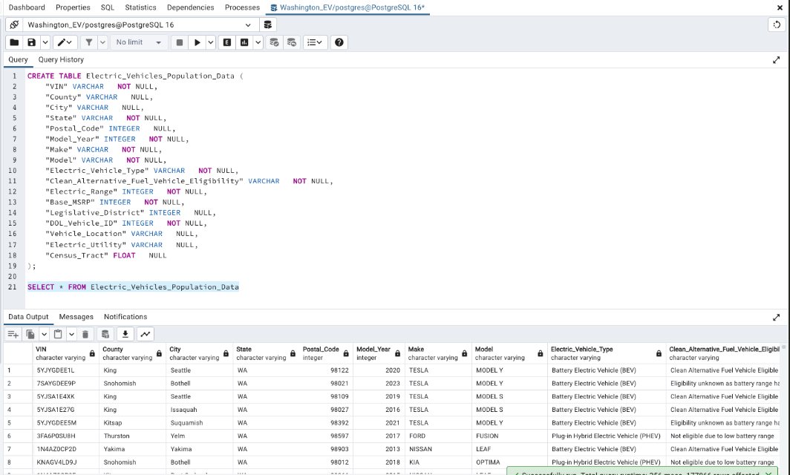
EV Database Review

Slide 12
Summary
This preliminary review of the data shows that Washington State has great potential to be an area we would expand to. Knowing the top and bottom ranked cities and counties for EVs assists us with pin-potting areas that could need additional charging stations and areas that may already be over-saturated with them. Cities such as Bellevue and Redmond could be areas to research further for the need of charging stations as they’re both located in King county which had the highest growth of EV registration. The data shows there is need for more research to be completed on vehicles that could be eligible for the CAFV tax exemption.

Slide 13
Thank You

